Slide 1
UVCE
Project Presentation

Slide 2
PROJECT :
TEAM :
Fake Review Detection
Mahith Shetty

Slide 3
Fake Review Detection
Acknowledgement
Acknowledgement
I would like to thank Dr. P Deepa Shenoy Ma’am, Dr. Tanuja Ma’am, Prashant Sir and Venkatesh Sir for giving us this opportunity to research on the solution that can help the Restaurants Owners and Customers.
I would also like to thank Nitin Jindal and Bing Liu for allowing me to use their labeled dataset for my project.
“The acknowledgement of a possibility can change anything.”

Slide 4
Fake Review Detection
Introduction
Introduction
Spam: Irrelevant or unsolicited messages sent over the Internet, typically to a large number of users, for the purposes of advertising, phishing, spreading malware, etc.
Fake Review: They’re reviews which are designed specifically to give a false impression to consumers on the point of purchasing.
“Any man travelling without an aim is already lost.”
Notes:
They don’t accurately reflect the product or service they’re talking about because they are designed to go after your wallet in the same way as “fake news” aims to dupe your thought processes. You’ll see both positive and negative fake reviews. “Fake positives” are the glowing reports that bear no resemblance to reality. “Fake negatives” are those that persuade you not to eat at a certain restaurant because it’s “known to have cockroaches in the kitchen” or not to go to a particular counsellor because “she ruined my life forever.” Negative fake reviews are written to persuade you not to take action on the product being reviewed. They are written to damage one company’s reputation and generally go on to recommend a different product from a competitor.

Slide 5
Fake Review Detection
Introduction
Types Of Spam
Web Spam and E-mail Spam:
Web spam describes web pages which have been created deliberately for triggering favourable relevance or importance on the Internet.
Review Spam:
Jindal and Liu (2007) were the first authors to study the trustworthiness of reviews. They argue that spam reviews are much harder to detect than regular web spam.
“Any work is easier said than done.”
Notes:
For Review Spam:
Jindal and Liu define three types of review spam:
• Untruthful opinions deliberately mislead readers or opinion mining systems by giving undeserving positive or malicious negative reviews to some target objects.
• Reviews on brands only do not comment on the products in reviews specifically but only on the brands, the manufacturers or the sellers of the products.
• Non-Reviews contain advertisements or no opinions. The main task in review spam detection is to identify the untruthful opinions. The other two types of spam can be identified more easily by a human reader and thus he/she can choose to ignore those.

Slide 6
Fake Review Detection
Problem Statement
Problem Statement
Positive/Negative Reviews influence buying decisions of buyers.
Sense of Uncertainty in customers mind plays into scammer’s / reviewer’s hands.
This may lead to loss of business and a bad name for the restaurant.
Important to make sure we create a level field for all restaurants.
No cheating/unfair means should be tolerated.
“Any work is easier said than done.”
Notes:
Nowadays, if one wants to buy a product, most probably, one will first read reviews of the product. If he/she finds that most reviews are positive, he/she is very likely to buy it. However, if most reviews are negative, he/she will almost certainly choose another product. Positive opinions can result in significant financial gains and fames for organizations and individuals. This, unfortunately, gives strong incentives for opinion spamming, which refers to human activities (e.g., writing fake reviews) that try to deliberately mislead readers by giving unfair reviews to some entities (e.g. products) in order to promote them or to damage their reputations

Slide 7
Fake Review Detection
Related Work
Related Work
Existing approaches to detect fake consumer reviews use the review content, product and reviewer information and other features to detect fake reviews.
However, as shown in recent studies, the semantic meaning of reviews might be particularly important for text classification. In addition, the emotions hidden in the reviews may represent another potential indicator of fake content.
Most related work to detect fake reviews is done using Machine Learning and researchers now have started shifting towards Deep Learning.
“Any work is easier said than done.”
Notes:
Group spamming refers to a group of reviewers writing fake reviews together to promote or to demote some target products. A spammer group can be highly damaging as it can take total control of the sentiment on a product because a group has many people to write fake reviews. Our experiments show that it is hard to detect spammer groups using review content features or even indicators for detecting abnormal behaviours of individual spammers because a group has more manpower to post reviews and thus, each member may no longer appear to behave abnormally.
Talk about how spammers operate in the real world. They do in groups etc.

Slide 8
Fake Review Detection
Objective
Objective
The goal of the project is to identify fake review spammers/reviewers in platforms such as CNET, Google, Amazon, Flipkart etc. so that these platforms can make informed policy decisions and take actions against these spammers/reviewers. These platforms can take data-driven decisions and can always stay one step ahead of group spammers.
To achieve this we have used a CNN-LSTM-LSTM algorithm on the dataset.
“Any work is easier said than done.”
Notes:
These priorities can be split up into the following points:
• Identify any group that may be reviewing the same products
• Try to establish if any malicious intent is present in the group
• Determine whether it is spam by applying behavioural models derived from the collusion phenomenon among fake reviewers and relation models based on the relationships among groups, individual reviewers, and products they reviewed to detect fake reviewer groups.
• Inform platforms about these fake reviews and expect them to remove these fake reviews as per their policies and terms.
Keerthana will take over from here

Slide 9
Fake Review Detection
Tools Used
Tools Used
Language Used: Python
Tool Used: Google Colab with TPU
Main Libraries Used
Pandas
Keras
NLTK
SkLearn
“Any work is easier said than done.”

Slide 10
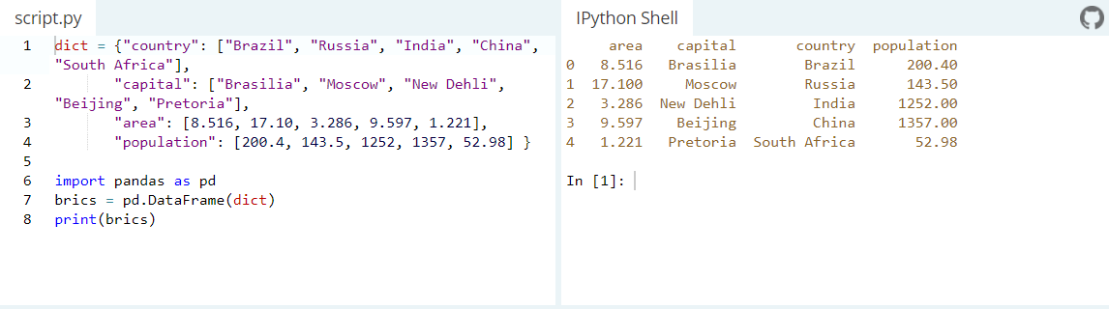
Fake Review Detection
Tools Used
Tools Used
Pandas:
It is a software library for data manipulation and analysis. In particular, it offers data structures and operations for manipulating numerical tables and time series. Visualize the data with help from Matplotlib - Plot bars, lines, histograms, etc.
“Any work is easier said than done.”
Notes:
This is an example for data frames. The one on the left has data in JSON format (Basically similar to CSVs we’ve used), the right part shows in terms of Data frames where it makes more sense

Slide 11
Fake Review Detection
Tools Used
Tools Used
Keras:
Keras is an open-source neural-network librar. It is capable of running on top of TensorFlow, Microsoft Cognitive Toolkit, R, Theano, or PlaidML. Designed to enable fast experimentation with deep neural networks.
NLTK:
The Natural Language Toolkit, is a suite of libraries and programs for symbolic and statistical natural language processing (NLP).
NLTK contains useful tools for text preprocessing and corpora analysis.
NLTK can be used for tokenization, count word frequencies, remove unwanted words, stemming, lemmatization and many more package.
“Any work is easier said than done.”
Notes:
Keras basically library to make Deep learning stuff. Explain different layers of ANN

Slide 12
Fake Review Detection
Tools Used
Tools Used
Scikit Learn:
It features various classification, regression and clustering algorithms.
Scikit Learn is a new easy-to-use interface for Tensor Flow from Google based on the Scikit-learn fit/predict model.
Scikit-learn makes use of a simple fit/predict workflow model for its classification algorithms. This makes building, training, and testing models incredibly easy.
“Any work is easier said than done.”
Notes:
Keras basically library to make Deep learning stuff. Explain different layers of ANN

Slide 13
Fake Review Detection
Data Set
Data Set
The dataset we have used is restaurants dataset from YELP.
The dataset consists of almost 7.5 Lakh labelled reviews.
Labels present:
Y – Fake Review
N – True Review
YR – Fake Filtered Review
NR – True Filtered Review
“Any work is easier said than done.”

Slide 14
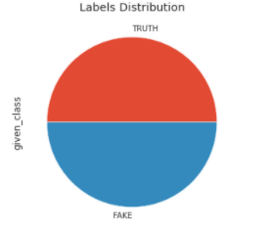
Fake Review Detection
Data Set
Data Set
We consider Y and YR as fake reviews and N and NR as true reviews.
We have selected reviews with length greater than 10 and in a random order.
The data-subset we have chosen consists of 5 Lakhs of equal parts of truthful and deceptive hotel reviews of restaurants.
“Any work is easier said than done.”
Notes:
About Data Set:
The dataset we have used is restaurants dataset from YELP. The dataset consists of 5 Lakhs of equal parts of truthful and deceptive hotel reviews of restaurants. We have combined different data sets to get a robust, versatile, accurate data set. Initially it was 7 lakh reviews, we selected 5 lakh most relevant reviews.
This was part of a yelp fake review detection challenge by Yelp. The data set was not labelled, we contacted a professor who had spent considerable amount of time on this, working on algorithms which labelled the set accurately. With minimum bias
Initially, we used a diverse dataset consisting of reviews from 4 major sources. The dataset had 1600 reviews in it
The data set is basically 2.5 lakh fake reviews and 2.5 lakh truthful reviews
They are evenly distributed among different geographies and economies, categories like 3star etc.
Fairly even distribution

Slide 15
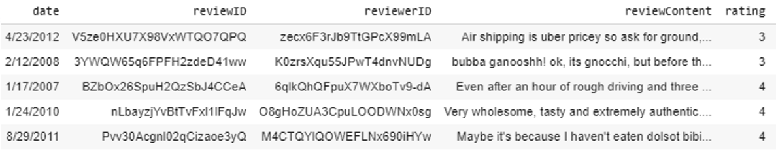
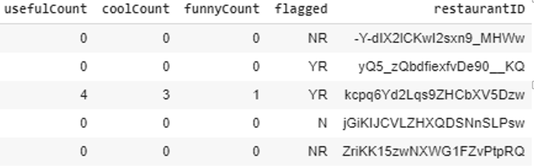
Fake Review Detection
Data Set
Data Set
“Any work is easier said than done.”

Slide 16
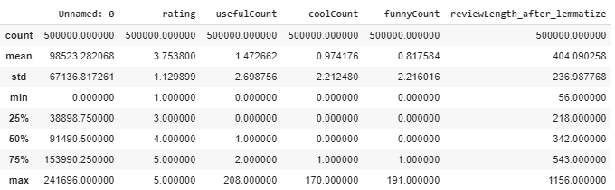
Fake Review Detection
Data Set
Data Set
Summary of numerical parameters in the dataset
“Any work is easier said than done.”

Slide 17
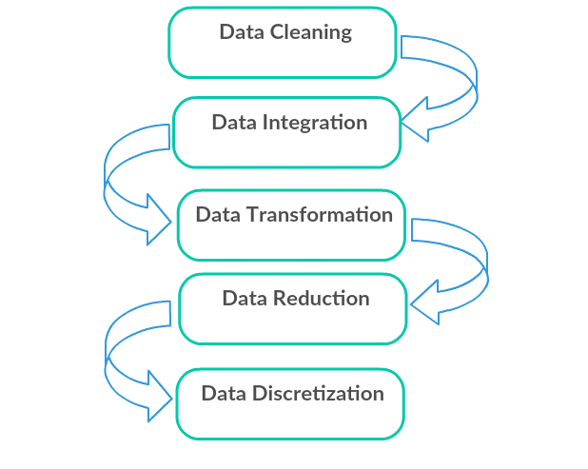
Fake Review Detection
Data Pre-Processing
Data Pre-Processing
Data pre-processing is a data mining technique which is used to transform the raw data in a useful and efficient format.
“Any work is easier said than done.”
Notes:
Data Cleaning:
Missing Data: This situation arises when some data is missing in the data. It can be handled in various ways.
Some of them are: –
Ignore the tuples: This approach is suitable only when the dataset we have is quite large and multiple values are missing within a tuple.
Fill the Missing values: There are various ways to do this task. You can choose to fill the missing values manually, by attribute mean or the most probable value.
Noisy Data: Noisy data is a meaningless data that can’t be interpreted by machines. It can be generated due to faulty data collection, data entry errors etc. It can be handled in following ways :
Binning Method: This method works on sorted data in order to smooth it. The whole data is divided into segments of equal size and then various methods are performed to complete the task. Each segmented is handled separately. One can replace all data in a segment by its mean or boundary values can be used to complete the task.
Regression: Here data can be made smooth by fitting it to a regression function. The regression used may be linear (having one independent variable) or multiple (having multiple independent variables).
Clustering: This approach groups the similar data in a cluster. The outliers may be undetected or it will fall outside the clusters.
Data Transformation:
This step is taken in order to transform the data in appropriate forms suitable for mining process. This involves following ways: • Normalization: It is done in order to scale the data values in a specified range (-1.0 to 1.0 or 0.0 to 1.0) • Attribute Selection: In this strategy, new attributes are constructed from the given set of attributes to help the mining process

Slide 18
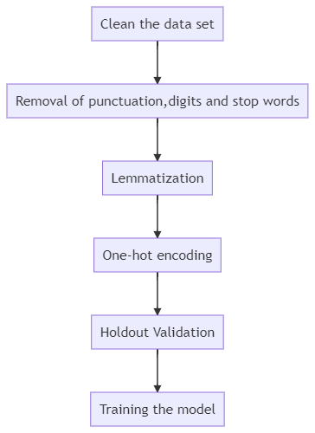
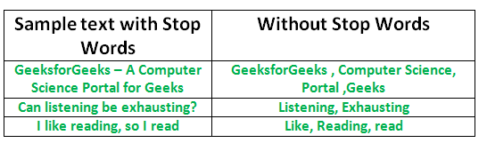
Fake Review Detection
Data Pre-Processing
Data Pre-Processing
Data Cleaning :
Remove Punctuations
Remove Numbers
Remove Stop Words
“Any work is easier said than done.”

Slide 19
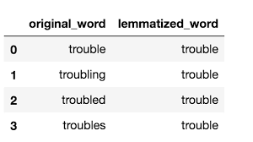
Fake Review Detection
Data Pre-Processing
Data Pre-Processing
Data Transformation:
Lemmatizing: It reduces the inflected words properly ensuring that the root word belongs to the language.
“Any work is easier said than done.”

Slide 20
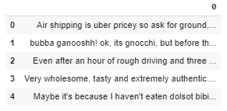
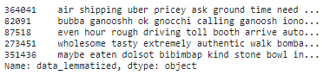
Fake Review Detection
Data Pre-Processing
Data Pre-Processing
Data Before
Data After cleaning and lemmatizing
“Any work is easier said than done.”

Slide 21
Fake Review Detection
Data Pre-Processing
One Hot Encoding
Data Transformation:
One hot Encoding:
Machine learning algorithms cannot work with categorical data directly.
Categorical data must be converted to numbers.
A one hot encoding allows the representation of categorical data to be more expressive.
“Any work is easier said than done.”
Notes:
The previous step kind of stems the word into the standard form or a minimum representation. So basically all “tenses”, and ways of representation will be gone
A one hot encoding is a representation of categorical variables as binary vectors.
This first requires that the categorical values be mapped to integer values.
Then, each integer value is represented as a binary vector that is all zero values except the index of the integer, which is marked with a 1.
In natural language processing, a one-hot vector is a 1 N matrix (vector) used to distinguish each word in a vocabulary from every other word in the vocabulary. The vector consists of 0s in all cells with the exception of a single 1 in a cell used uniquely to identify the word. One-hot encoding ensures that machine learning does not assume that higher numbers are more important. For example, the value ’8’ is bigger than the value ’1’, but that does not make ’8’ more important than ’1’. The same is true for words: the value ’New York’ is not more important than ’York’.

Slide 22
Fake Review Detection
Data Labeling
Data Labelling
We have reviews labelled as Y, YR, N and NR.
We label the review Y and YR as FAKE and N and NR as TRUTH.
All FAKE labels are further labelled as 1 and TRUTH labels are represented as 0.
“Any work is easier said than done.”

Slide 23
Fake Review Detection
Splitting the data
Splitting the data
We split Train and Test data in the ratio 80:20.
Round 1 : Hold Out Set / K – Fold Cross Validation
We split the train data in the ratio 90:10.
90% data for training and the10% for validation.
Round 2 : On Entire Training Data
“Any work is easier said than done.”
Notes:
4 lakh reviews: Training
1 lakh reviews: Testing
3. Highest accuracy with 80-20, tried diff configs like 70-30 and 90-10

Slide 24
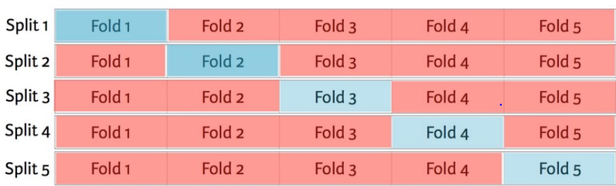
Fake Review Detection
Validation Mechanisms
Validation Schemes
K – Fold Cross Validation
Within each set in the holdout validation process, we use k-fold validation method
The data set is divided into k subsets, and the holdout method is repeated k times. Each time, one of the k subsets is used as the validation set and the other k-1 subsets are put together to form a training set. In our case k = 5.
It prevents overfitting.
“Any work is easier said than done.”
Notes:
The whole dataset is randomly shuffled. So no related data is together.
The data set is divided into k subsets, and the holdout method is repeated k times. Each time, one of the k subsets is used as the test set and the other k-1 subsets are put together to form a training set. Then the average error across all k trials is computed. The advantage of this method is that it matters less how the data gets divided. Every data point gets to be in a test set exactly once, and gets to be in a training set k-1 times.. K = 5 in our case
The model is trained k-1 times essentially.

Slide 25
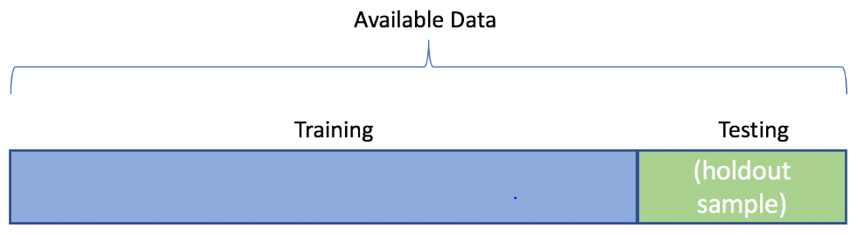
Fake Review Detection
Validation Mechanisms
Validation Schemes
Hold Out Set Validation
Holdout is when you split up your dataset into a ‘train’ and ‘validation’ set.
The training set is what the model is trained on, and the validation set is used to see how well that model performs on unseen data.
The holdout method is good to use when you have a very large dataset.
The cross-validation uses multiple train-test splits, it takes more computational power and time to run than using the holdout method.
“Any work is easier said than done.”

Slide 26
Fake Review Detection
Deep Learning Model
Keras Embedding Layer
Keras offers an Embedding layer that can be used for neural networks on text data.
It requires that the input data be integer encoded, so that each word is represented by a unique integer.
The Embedding layer is initialized with random weights and will learn an embedding for all of the words in the training dataset
“Any work is easier said than done.”
Notes:
1. The Embedding layer is initialized with random weights and will learn an embedding for all of the words in the training dataset.
2. Vocabulary = 4 lakh words
3. Review Length = 155 words
4. 256 features output
5. Output is a review in terms of vectors with 256 features

Slide 27

Fake Review Detection
Deep Learning Model
Convolution Neural Network
The role of the CNN is to reduce the size of the review which is easier to process, without losing features which are critical for getting a good prediction.
Here, we use CNN 1D - as each review is associated with a 1 dimensional vector - to extract the important features from the reviews.
“Any work is easier said than done.”

Slide 28
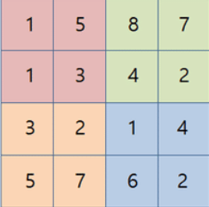
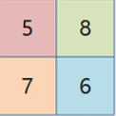
Fake Review Detection
Deep Learning Model
Max Pooling
The Pooling layer is responsible for reducing the spatial size of the Convolved Feature.
Max Pooling returns the maximum value from the portion of the image covered by the Kernel.
It is useful for extracting dominant features.
“Any work is easier said than done.”

Slide 29

Fake Review Detection
Deep Learning Model
Global Max Pooling
Global pooling down samples the entire feature map to a single value.
Global pooling can be used in a model to aggressively summarize the presence of a feature in an image.
In this, pool size = size of input feature map.
“Any work is easier said than done.”

Slide 30
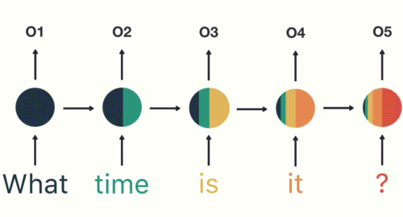

Fake Review Detection
Deep Learning Model
Recurrent Neural Network
RNN’s are good at processing sequence data for predictions.
Sequential memory is a mechanism that makes it easier for your brain to recognize sequence patterns.
Disadvantage: Short-term memory is caused by the infamous vanishing gradient problem.
“Any work is easier said than done.”

Slide 31

Fake Review Detection
Deep Learning Model
Recurrent Neural Network
RNN’s are good at processing sequence data for predictions.
Sequential memory is a mechanism that makes it easier for your brain to recognize sequence patterns.
Disadvantage: Short-term memory is caused by the infamous vanishing gradient problem.
“Any work is easier said than done.”

Slide 32
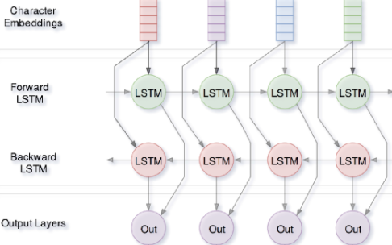
Fake Review Detection
Deep Learning Model
Long Short Term Memory
LSTM ’s was created as the solution to short-term memory.
These gates can learn which data in a sequence is important to keep or throw away.
Bi-LSTM: We duplicate the first recurrent layer in the network to get two layers side-by-side, then providing the input sequence as-is as input to the first layer and providing a reversed copy of the input sequence to the second
“Any work is easier said than done.”

Slide 33
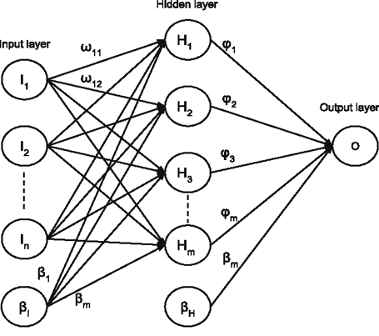
Fake Review Detection
Deep Learning Model
Dense
A dense layer is a classic fully connected neural network layer : each input node is connected to each output node.
A dense layer used as the last layer is also called the output layer.
The output layer has only one neuron whose output is either 0 or 1. (Fake or Truth)
“Any work is easier said than done.”

Slide 34
Fake Review Detection
Deep Learning Model
Batch Normalization
The goal of Batch Normalization is to achieve a stable distribution of activation values throughout training.
For example, when we have features from 0 to 1 and some from 1 to 1000, we should normalize them to speed up learning.
To increase the stability of a neural network, batch normalization normalizes the output of a previous activation layer by subtracting the batch mean and dividing by the batch standard deviation.
“Any work is easier said than done.”

Slide 35
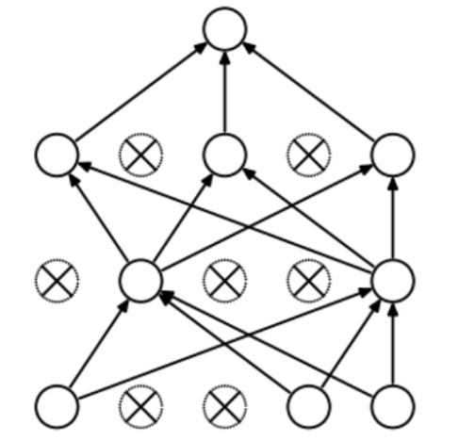
Fake Review Detection
Deep Learning Model
Dropout
Dropout refers to not considering neurons during the training phase of certain set of neurons which is chosen at random.
At each training stage, individual nodes are either dropped out of the net with probability 1-p or kept with probability p.
Dropout is used to prevent Over Fitting.
Spatial Dropout : This version performs the same function as Dropout, however, it drops entire 1D feature maps instead of individual elements.
“Any work is easier said than done.”

Slide 36
Fake Review Detection
Deep Learning Model
L1 and L2 Regularizers
L1 Regularization shrinks the less important feature’s coefficient to zero thus, removing some feature altogether. L1 Regularization works well for feature selection in case we have a huge number of features.
L2 regularization forces the weights to be small but does not make them zero and does non sparse solution.
L1 will simply pick one of the two predictors. In contrast, the L2 will keep both of them and jointly shrink the corresponding coefficients a little bit.
Regularization prevent overfitting.
“Any work is easier said than done.”

Slide 37
One Hot Vectors
+
Vocabulary
Keras Embedding
SD
CNN 1D
R
D
Adam Optimizer
Learning Rate: 0.0001
Epochs: 10
Batch Size: 1024
Max Pool 1D
D
BN
Bi - LSTM
R
BN
Bi - LSTM
R
BN
Global Max Pooling 1D
Dense
R
Output Dense Layer
Prediction
BN
Batch Normalization
R
(Fake/True)
D
Dropout
SD
Spatial Dropout
R
Regularizers

Slide 38
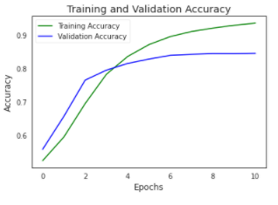
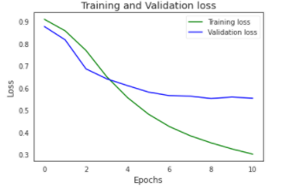
Fake Review Detection
Execution
Round 1: With Hold Out Validation
Train Accuracy : 93.34 %
Validation Accuracy : 84.43%
Training and Validation Accuracy
Training and Validation Loss
“Any work is easier said than done.”

Slide 39
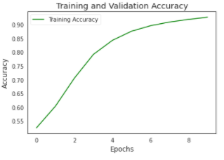
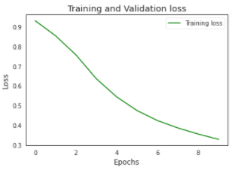
Fake Review Detection
Execution
Round 2: On Entire Training Data
Train Accuracy : 92.64 %
Test Accuracy : 85.108 %
Training Accuracy
Training Loss
“Any work is easier said than done.”

Slide 40

Universal Interpreter
Conclusion

Slide 41
Fake Review Detection
Concluding Remarks
Conclusion
In Fake Review Detection the aim is always to identify the highest number of fake reviews that is possible to be able -
To provide potential customers with a realistic picture of the restaurant they are informing themselves about.
To prevent any harm to restaurants reputation.
The deep learning model used produces decent yet improvable results.
“What matters the most is the take-away.”

Slide 42
Fake Review Detection
Future Scope
Future Scope
Create an API which can detect fake reviews in minimal time.
Feature Selection : Explore the dataset to find minute yet important features that would help increase the accuracy.
Word Embedding's : Pre-trained Embedding's could help convert the word to vectors in a more precise way.
“All progress takes place outside the comfort zone.”

